Slide 1


Network based analysis for the identification of key regulatory genes in cancer
Ines de Santiago
17 April 2015

Slide 2
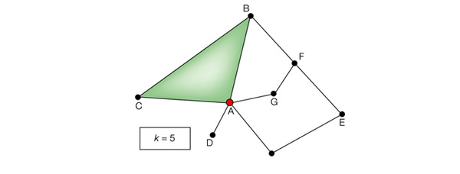
Network biology
“Network biology offers a quantifiable description of the networks that characterize various biological systems”.
- Albert-László Barabási & Zoltán N. Oltvai. Nat, Reviews 2004
A basic graph…

Slide 3
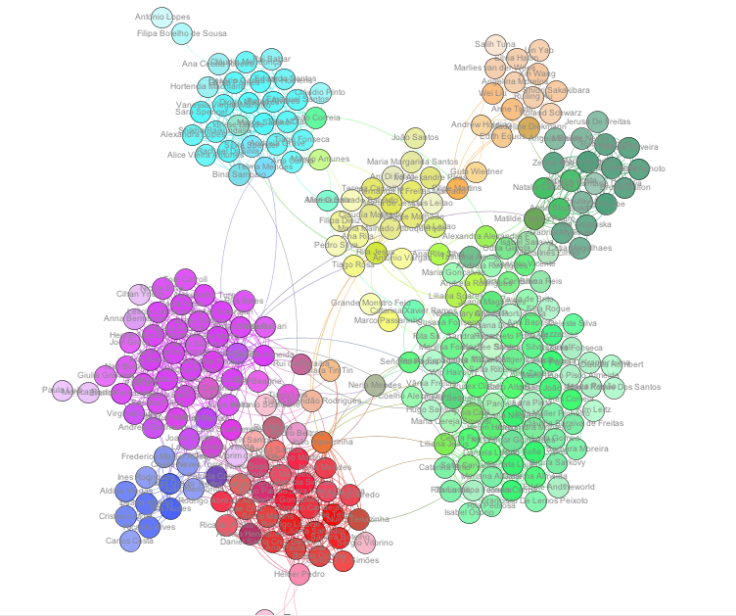
The facebook network
(Make your own: http://snacourse.com/getnet)
university
Tathiana Santana
Friends from home town
Tom Carroll
Science
Portuguese speaking
(London / Cambridge)
Portugal
Cambridge
London

Slide 4
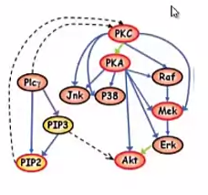
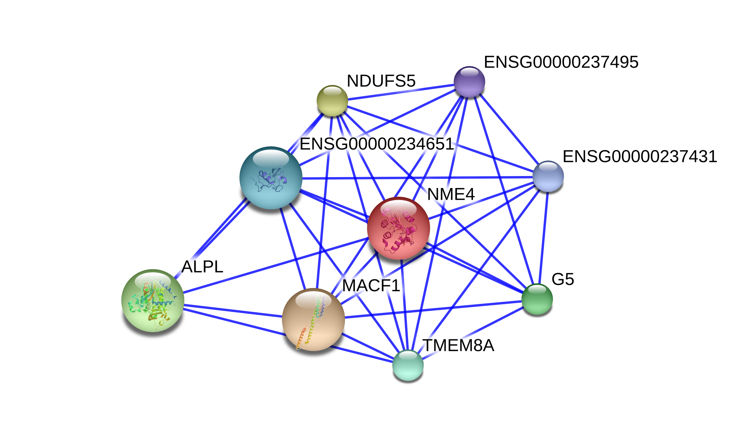
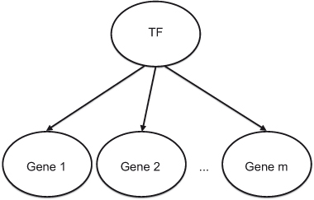
Types of networks ( = different types of maps functional interactions)
Cell signaling pathways
Transcriptional regulatory networks
Protein-Protein interaction networks
– Protein complexes
- Protein interactions
– Ordered sequences of biochemical reactions in a cell
– Changes induced by
Receptor (protein that receives and
responds to a stimulus) activation

Slide 5



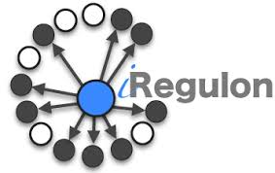






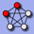


Sources of networks
Data base
Network
Examples of how to get it
Experimental knowledge on metabolism and various other functions of the cell
by large scale multiple perturbation data (Sachs et al Science 2005)
Cell-signaling
Networks
Directly from TF ChIP-seq data
From TFBS predictions (motifs)
Network inference from gene expression data
Transcriptional
regulatory networks
Yeast-2-hybrid (Y2H) screens
Affinity purification mass spectrometry
Coimmunoprecipitation
Text-mining from the literature
Protein-Protein interaction networks
Integrative solutions:
include also miRTarBases, drugBank, PhosphoSite Kinase-substrate, Transfac, GEO datasets, etc)
iRefIndex

Slide 6
contents
How to construct a gene co-expression network in R?
Why use mutual information?
How to identify master regulators of a signature response?
How to integrate derived networks with publically available network data?
Examples in breast cancer, pancreatic cancer and lung cancer.

Slide 7
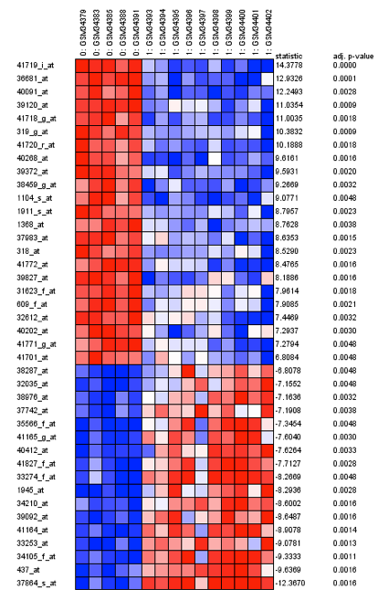
Standard differential expression analysis vs. Master regulator analysis
Differentially expressed genes can be organized into relatively few groups
Possibly converging into a few “Master regulators” of specific cellular phenotypes
Master regulator
TF
target genes

Slide 8
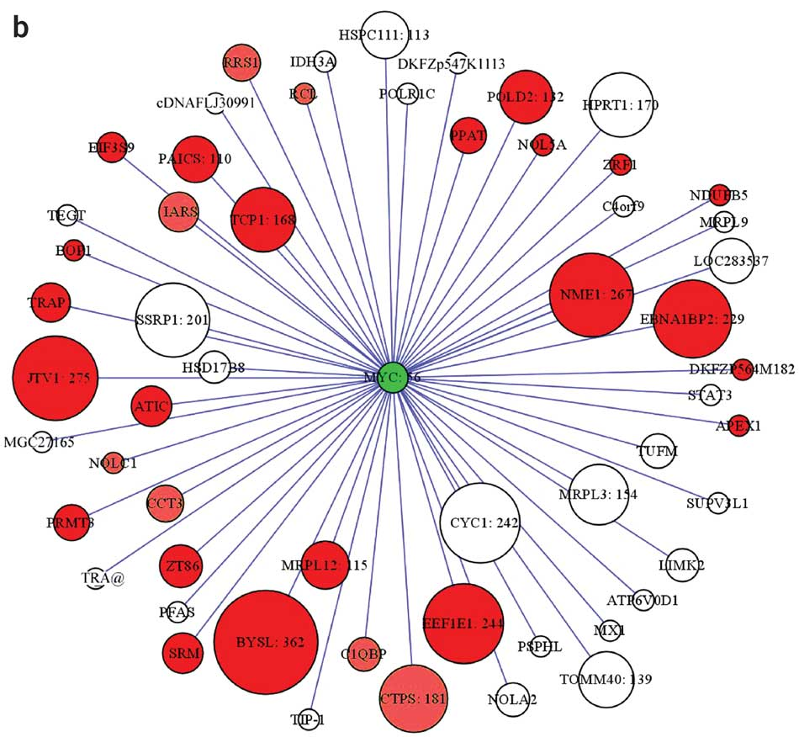
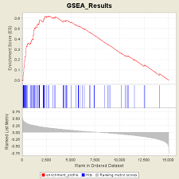
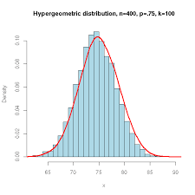
Master regulator analysis (Califano’s lab)
Build a regulatory network (ARACNe software)
Regulon of cMyc
Basso K et al., (2005), Nat. Genet. 37(4):382-90 Margolin AA et al., (2006), BMC Bioinformatics 7:Suppl. 1(S7)
Margolin AA et al., (2006), Nature Protocols 1(2):662-671 Palomero T et al., (2006), Proc. Natl. Acad. Sci. USA 103:18261-266
Nemenman I et al., (2007), Ann. NY Acad. Sci. 1115:102-115
2. MARINa (Enrichment analysis)
a) GSEA
b) Hypergeometric distribution
Zhao X et al., (2009), Dev. Cell, 17, pp. 210–221
Lefebvre, C. et al., (2010), Mol. Syst. Biol. 6, 377
Carro, M. S. et al., (2010) Nature 463, 318-25
Sumazin P et al., (2011), Cell, 147, pp. 370–381
Piovan E. et al., (2013), Cancer Cell, 24, pp. 766–776
Aytes A. et al., (2014), Cancer Cell, 25, pp. 638–651
Regulon
Regulon
DEG
genes
DEGs

Slide 9
From gene expression matrix to a network – the inference problem
Input: gene expression data matrix – the result of an microarray/RNA-seq experiment
Assumptions:
Un underlying network exists connecting pairs of genes
Gene expression measurements across samples contain information on the connectivity of TFs with their target genes
The Problem: Given a gene expression matrix can we resolve the underlying – unknown - network.

Slide 10
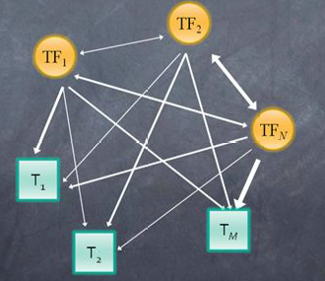
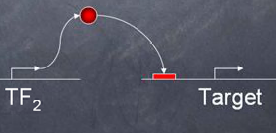
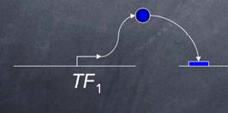
ARACNe: reverse engineering regulatory networks
Compute all pairwise TF-target interactions
(nodes are TFs)

Slide 11
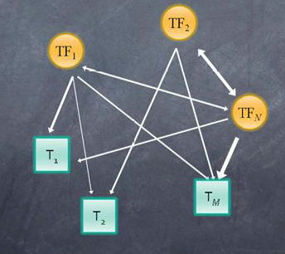
ARACNe: reverse engineering regulatory networks
Compute all pairwise TF-target interactions
Remove interactions that are not significant

Slide 12
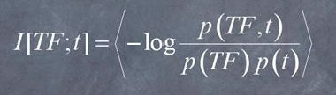
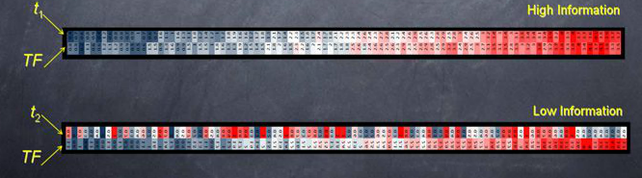
Mutual Information
Start with a large collection of gene expression data
Select two genes: A TF and a candidate target
Use expression across multiple expressions to measure p(TF), p(t), p(TF,t)

Slide 13
ARACNe: reverse engineering regulatory networks
Apply data processing inequality (DPI)
This Network contains indirect interactions
Application of DPI helps us remove those indirect interactions

Slide 14
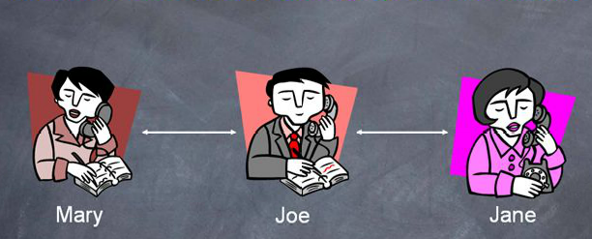
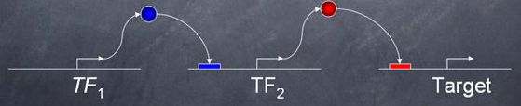
Data Processing Inequality (DPI)
I[Mary; Jane]
I[Mary;Joe]
I[Joe; Jane]

Slide 15
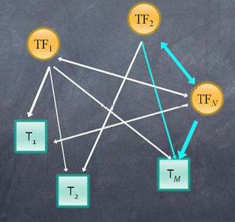
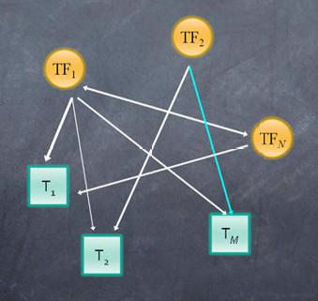
ARACNe: reverse engineering regulatory networks
Apply data processing inequality (DPI)

Slide 16
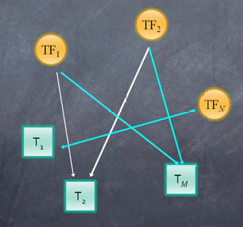
ARACNe: reverse engineering regulatory networks
Final network has a much smaller number of interactions

Slide 17
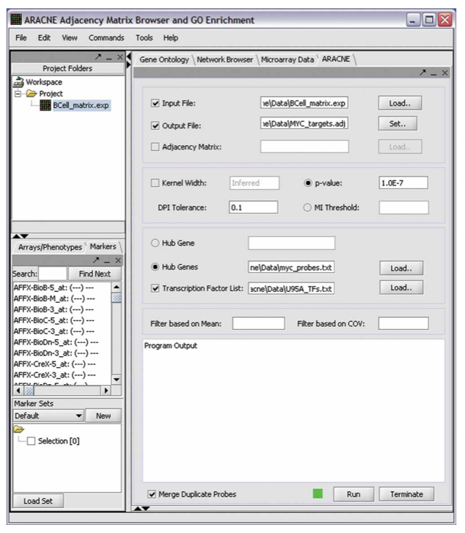

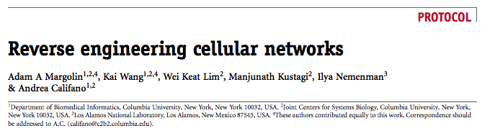
ARACNe and MARINA software (Califano’s lab)

Slide 18
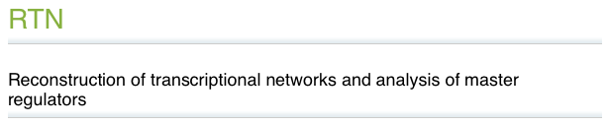
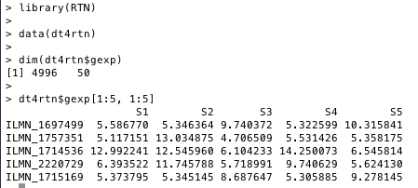
INPUT DATA
Mauro Castro
http://www.bioconductor.org/packages/release/bioc/html/RTN.htm
Example dataset
50 columns and 4,996 probes

Slide 19
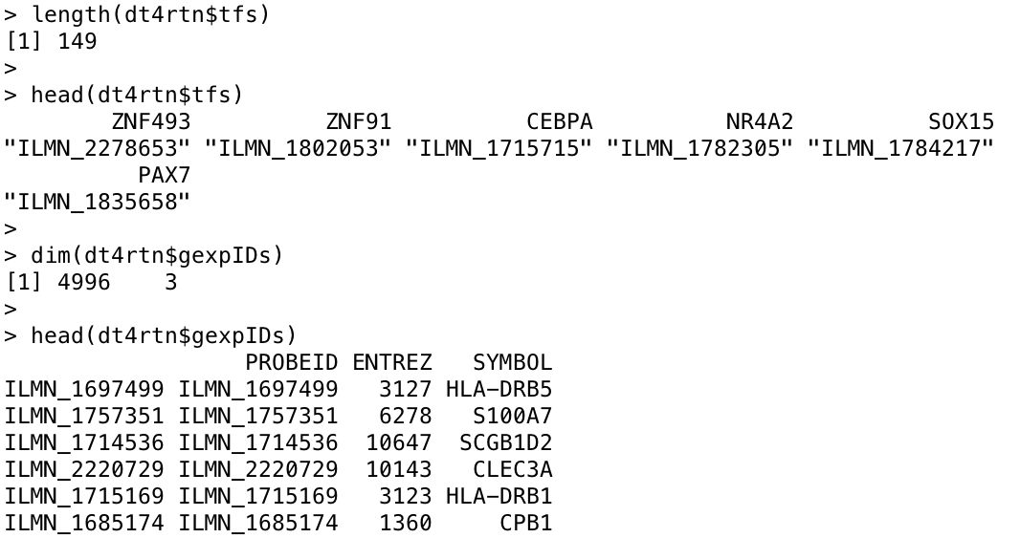
INPUT DATA
http://www.bioconductor.org/packages/release/bioc/html/RTN.htm
a named vector with TF ids
an optional data frame with gene annotation (it can be used to remove duplicated genes)

Slide 20
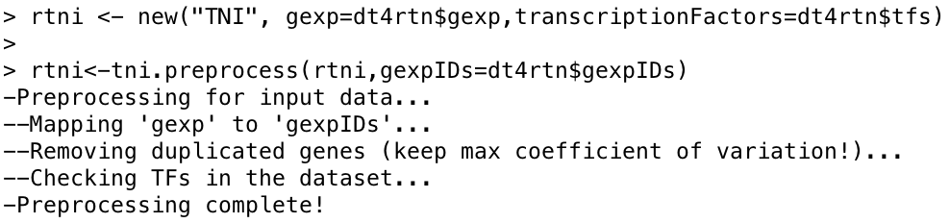
PREPROCESS
http://www.bioconductor.org/packages/release/bioc/html/RTN.htm

Slide 21
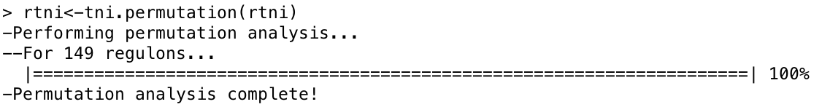
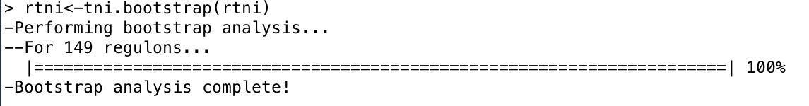
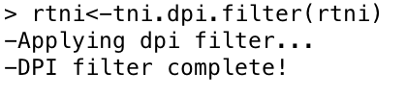
3 STEP RUN
1. Permutation
2. Bootstrap
3. DPI filter

Slide 22
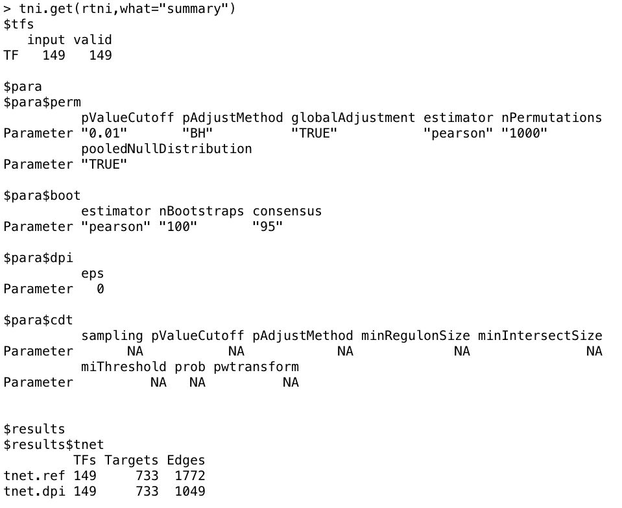
GET RESULTS
All results available in the TNI object can be retrieved using the tni.get function

Slide 23
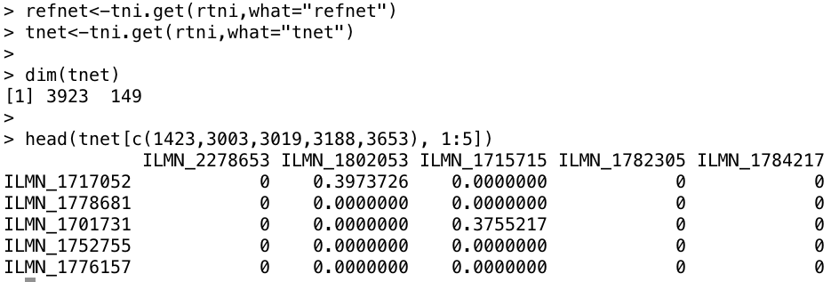
GET RESULTS

Slide 24
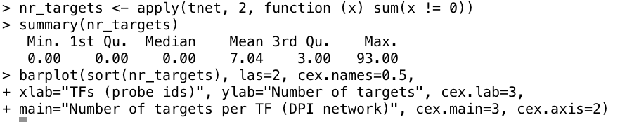
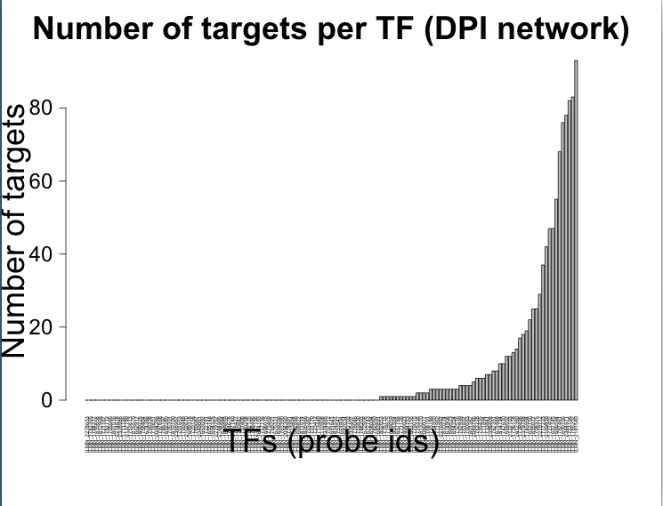
Number of targets per TF

Slide 25
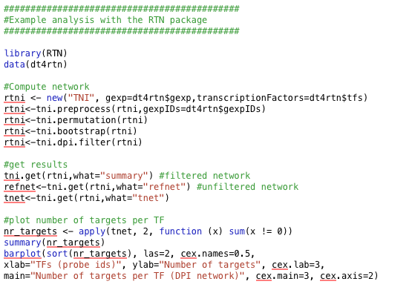
Code used so far
http://inesdesantiago.github.co.uk

Slide 26
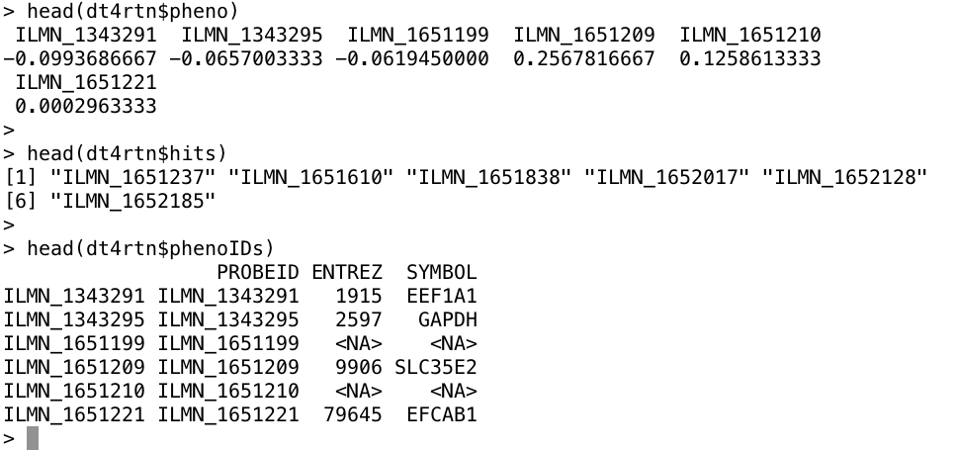
MRA analysis (MARINa algorithm): INPUT DATA
a named numeric vector of phenotypes
a character vector of gene ids considered as hits
an optional data frame with annotation used to aggregate genes in the phenotype

Slide 27
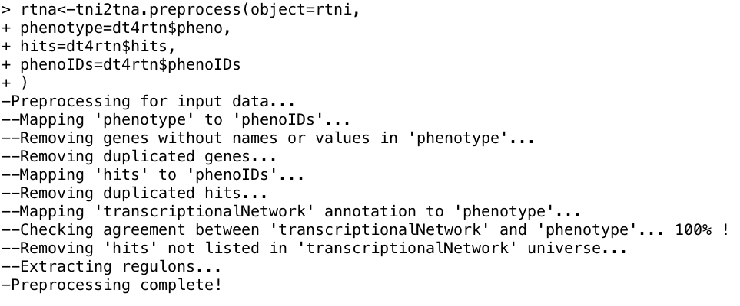
MRA analysis (MARINa algorithm): PREPROCESSING

Slide 28
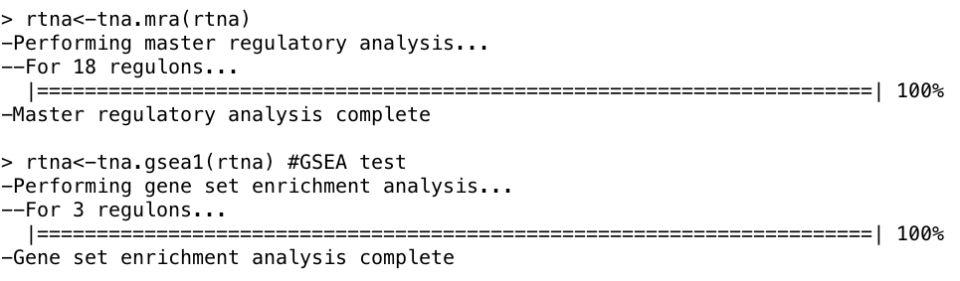
MRA analysis (MARINa algorithm): ENRICHMENT ANALYSIS
Using the hypergeometric distribution
Using the GSEA test

Slide 29
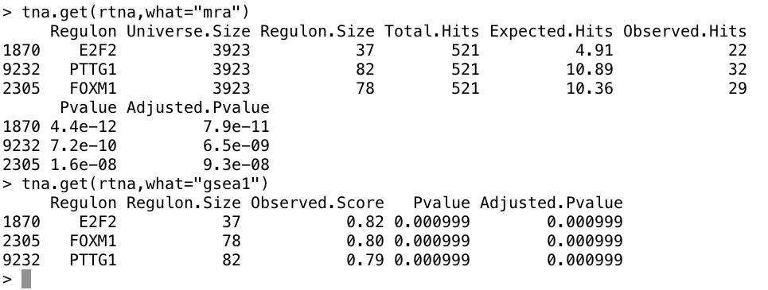
MRA analysis (MARINa algorithm): GET RESULTS

Slide 30
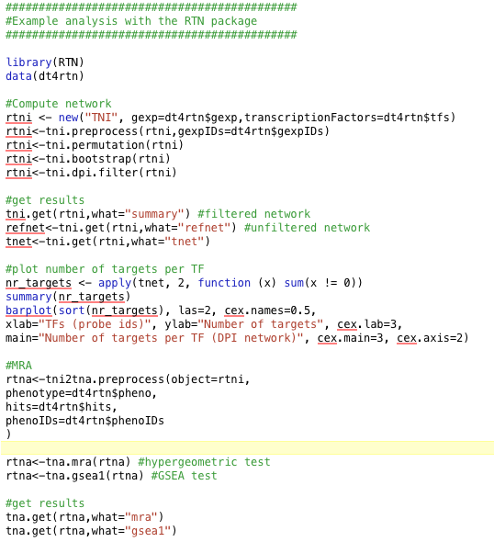
Code used so far (15 lines of code!)
http://inesdesantiago.github.co.uk

Slide 31

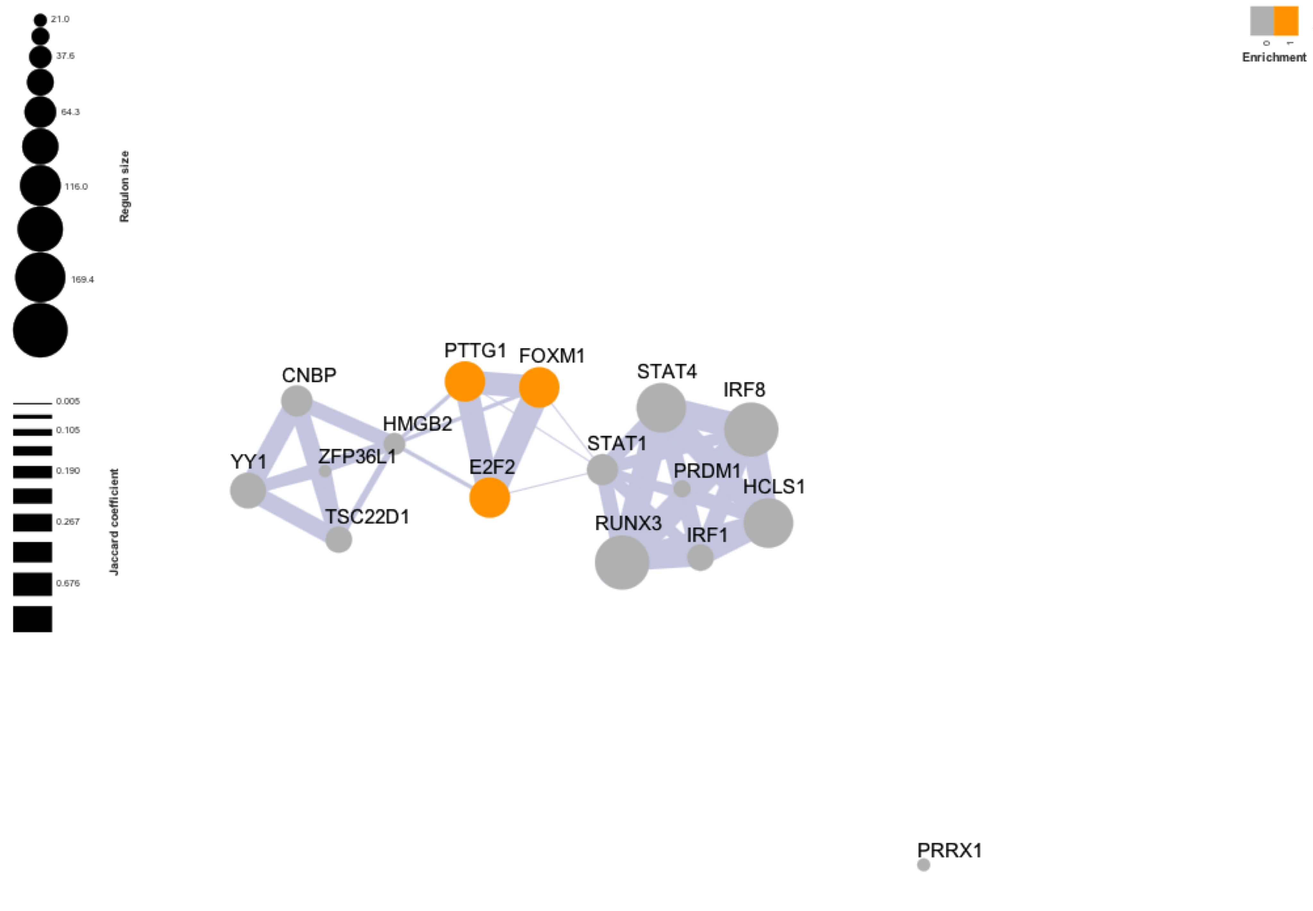
http://www.bioconductor.org/packages/release/bioc/html/RedeR.html

Slide 32
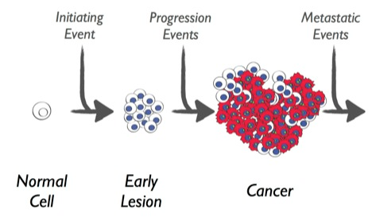
Network-based approach to identify genes and pathways involved in cancer
Identify key drivers of cancer:
How acquired mutations initiate the neoplastic process and ultimately lead to malignant disease?
Expression: microarray, RNA-seq data
Data integration:
Gene IDs can be used as anchors for integrating different omics datasets
What genes? What pathways?
SNP data (eQTLs) - How do genetic variants, each with small effects, contribute to cancer susceptibility?

Slide 33
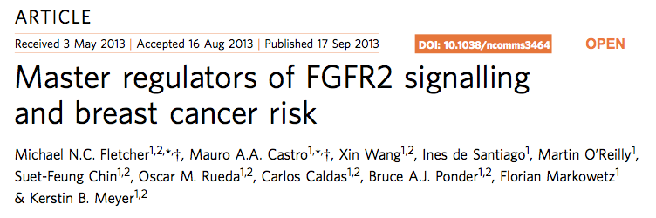
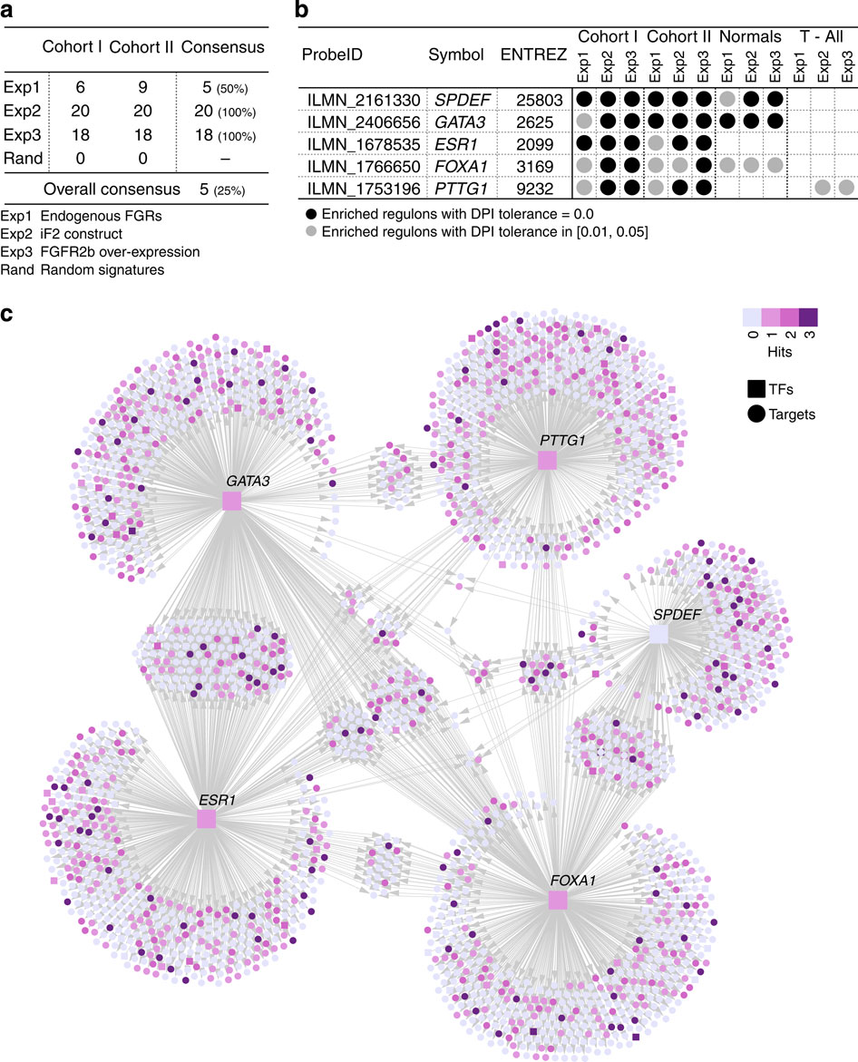
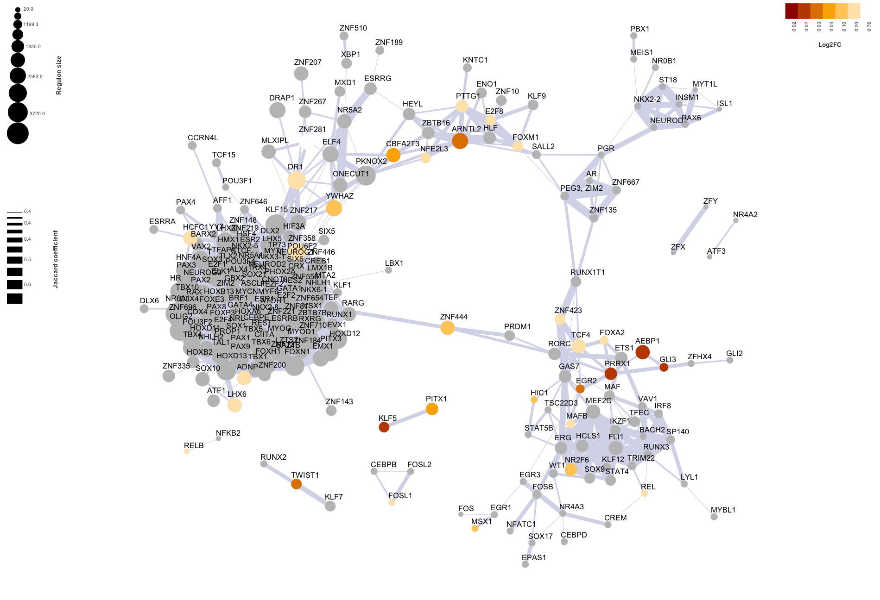
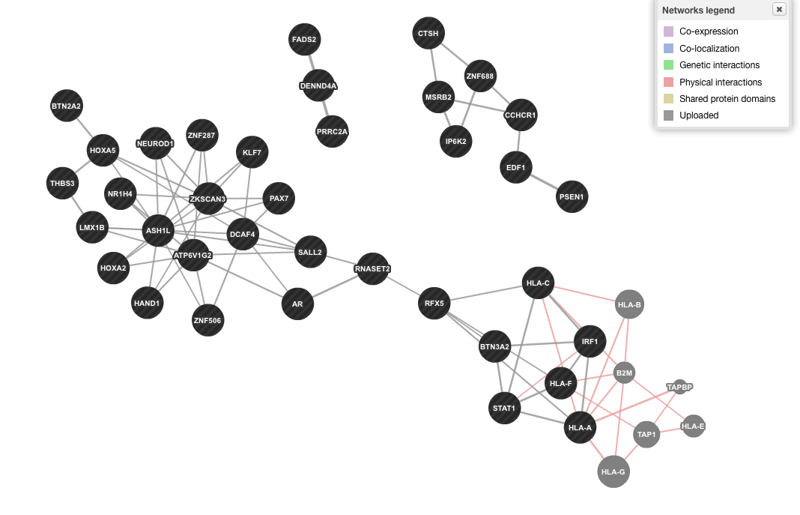
Research overview
Unpublished
Breast cancer
Pancreatic cancer
Lung cancer
Master regulators of KRAS response in PDAC tumours
Critical TFs associated to squamous lung cancer risk
ESR1, GATA3, FOXA1, SPDEF, PTTG1
TEAD3, GLI3, PRRX1, TWIST1 and RELA, etc
AR, IRF1, STAT3 and RFX5

Slide 34
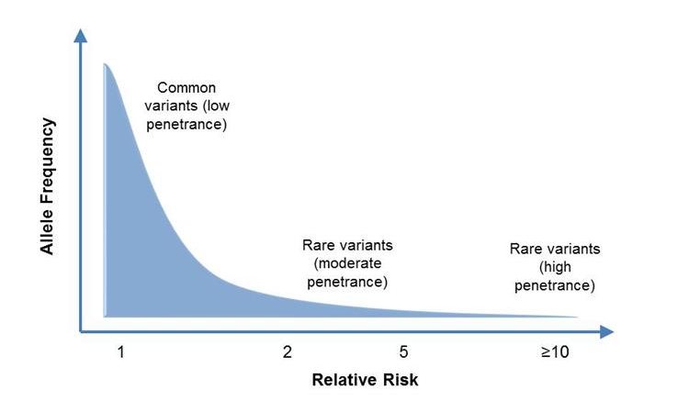
Breast cancer and FGFR2 amplification
FGFR2 gene is a mediator of breast cancer risk
FGFR2 gene encodes a tyrosine kinase receptor.
Top GWAS hit rs2981578 lie in intron2 10q26 of FGFR2
Fibroblast growth factors can act as oncogenes in murine mammary cancers FGFR2is amplified andover-expressed in 5-10% of human breast tumours
Although consistently the ‘top hit’ in GWAS, we still have little knowledge of the cellular pathways that are perturbed in cancer predisposition.
Aim:
Uncover the molecular mechanism underlying breast cancer risk.
Identifying TFs acting as MR of the FGFR2 response
FGFR2; CASP8
PTEN; CHEK2
BRCA1/2; TP53; RB1
PALB2
ATM

Slide 35
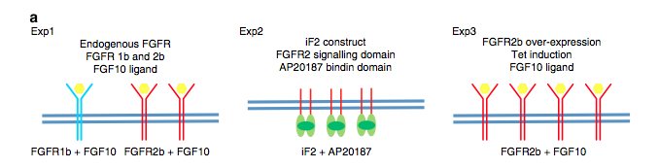
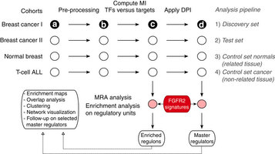
Breast cancer results: Overview
1. Stimulation of FGFR2 expression in MCF7 (ER+) breast cancer cell lines
2. Human breast cancer dataset of gene expression measurements over ~2000 breast tumors

Slide 36
Breast cancer results: Overview

Slide 37
Pancreatic Cancer and KRAS mutations
In most cases (>90%), PDAC is initiated by oncogenic mutant KRAS
Lack of targeted therapies for KRAS
Through multiple effectors (PI3K/mTOR and MEK/ERK), KRAS regulates cell proliferation, and survival
KRAS is widely assumed to be undruggable
Aim:
Understand oncogenic KRAS signaling
Identify druggable downstream effectors of oncogenic KRAS
KRAS mutation is sufficient to initiate neoplasia

Slide 38




Pancreatic cancer results: Overview
1. Mouse model of KRAS activation oncogenic Kras is capable of initiating PDAC
~11k orthologous genes in human
2. Human PDAC datasets: 4 independent studies
TF-targets network derived using
Expression data from 114 PDAC
Human samples

Slide 39

Pancreatic cancer results: Overview
GSEA (pvalue)
Regulon size
Jaccard coefficient

Slide 40
Pancreatic cancer results: Overview
Regulon size
Activation of oncogenic RAS involves:
the activation of the transcription factor NF-kB (RELA, PML, AEBP1, TRIM28, RUNX1)
mis-regulation of pro- liferation/apoptosis (KLF5, KLF6, USF2, NFIB)
promotion of angiogenesis and stimulation of invasion/metastasis (TWIST1, GLI3, TRIM29)
Upstream
Upstream
Downstr
Jaccard coefficient
Downstr
Upstream
Downstr
Upstream
Downstr
Upstream

Slide 41



Overview of results
Pancreatic cancer results: Overview
Pancreatic cancer results: Overview
It has been shown that genetic deletion he RELA/p65 subunit of NF-kB is able to suppress KRAS-induced tumorigenesis in lung (Bassères et al, 2010).
TEAD3 plays a role in the hippo pathway (kinase cascade that regulates cell proliferation, migration/invasion)
NF-kB, PDAC
2012
TEAD3
RELA/p65.
Lung, 2010
RELA/p65
Experiments ongoing: IHC with phospho-specific Abs, phospho westerns, ChI-seq
Shivan Sivakumar

Slide 42

Lung cancer susceptibility
Cigarette smoking is a causative factor lung cancer
Only ~15% of smokers develop cancer
Only 25% of smokers develop chronic obstructive pulmonary disease (COPD)
Which smokers are at highest risk?

Slide 43

Lung cancer susceptibility
Can we obtain a gene expression ‘readout’ of these SNPs?
How heterogeneous are the mechanisms through which SNPs work?
Can gene expression ‘readout’ of SNPs be extended to include the effects of interaction with exposures?

Slide 44

Lung cancer results: Overview
123 risk SNPs
(TRICL consortium)
15q25.1 (nicotinic acetylcholine receptors)
6p21.33
5p15.33
3q28
Gene expression profiling from large airway epithelium from 163 individuals
(Spira et al., 2007)
eQTLs obtained from 1,111 cases genotyped and profiled (Lung parenchyma samples from non-neoplastic tissue)

Slide 45
Lung cancer results: Overview
Physical interactions
Co-expression
(This study)
Transcription factors
Target genes (also eQTLs)
Literature
The molecular mechanisms by which inflammation promotes cancer development are still being uncovered
Development & Differentiation (HOXA2, HOXA5, PAX7, HAND1, LMX1B, NEUROD1, KLF7)
TGFb pathway (THBS3)
Respond to inflammation

Slide 46
Summary
Network-based analysis provide a way of understanding the molecular pathways and mechanisms triggered by a cellular response (FGFR2, oncogenic RAS)
New way of mapping lung cancer GWAS hits onto a regulatory network – may provide a way of identifying new ‘risk TFs’
Can we identify the biological mechanisms/pathways that confer risk?
Can we provide a means to identify genetically susceptible individuals who may be ‘more’ at risk of the adverse effects of smoking?

Slide 47

Github page where the material can be found
Slides and code:
https://github.com/InesdeSantiago/NetworkAnalysisTalk_April2015/

Slide 48




Acknowledgments
Mauro Castro (RTN package)
Shivan Sivakumar (Pancreatic cancer)
Florian Markowetz
(network analysis)
Bruce Ponder (Lung cancer)
Kerstin Meyer (Breast cancer)

